Slide 1
Introduction to Fadecandy
ILD 6th of April 2016

Slide 2
What’s in the kits
Fadecandy
Power cables
Neopixel 8x8 matrix
LED Strip

Slide 3
Setup
(source: https://github.com/scanlime/fadecandy)

Slide 4
Getting started
Download the library from https://github.com/scanlime/fadecandy
Run the server from the Terminal (Mac)
cd ~/Downloads/fadecandy-master/bin
open fcserver-osx
Open the fadecandy-master/bin folder and run fcserver.exe (windows)
Open Processing and run your program.

Slide 5
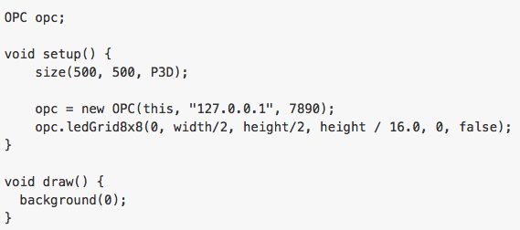
Creating a new program
Open Pixel Control (OPC)
Define screen size
Setup the server connection
Define LED type
Port
Midpoint
Spacing
Rotation
Direction

Slide 6
Changing individual pixels
setPixel(index, color);
opc.setPixel(0, color(255,0,0));
for (int i = 0; i < 8; i++) {
opc.setPixel(i+8*0, color(255,0,0));
opc.setPixel(i+8*1, color(0,255,0));
opc.setPixel(i+8*2, color(0,0,255));
opc.setPixel(i+8*3, color(127,0,0));
opc.setPixel(i+8*4, color(0,127,0));
opc.setPixel(i+8*5, color(0,0,127));
opc.setPixel(i+8*6, color(100,100,100));
opc.setPixel(i+8*7, color(200,200,200));
}
opc.writePixels();

Slide 7
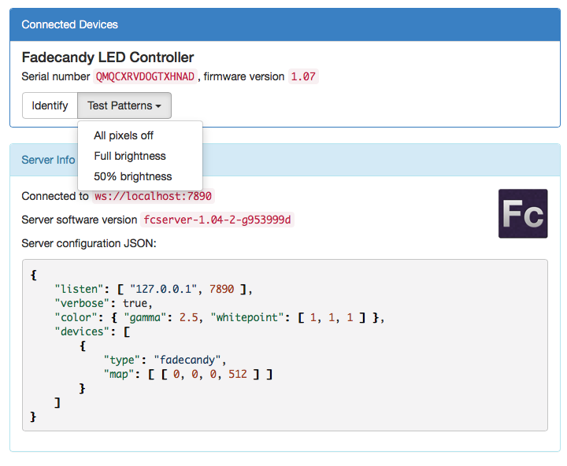
Webserver
http://localhost:7890
Number specified in your code
Make sure the server is running
Turn off all LEDs
Test LEDs
Identify Fadecandy

Slide 8
Premade Examples (dot)

Slide 9
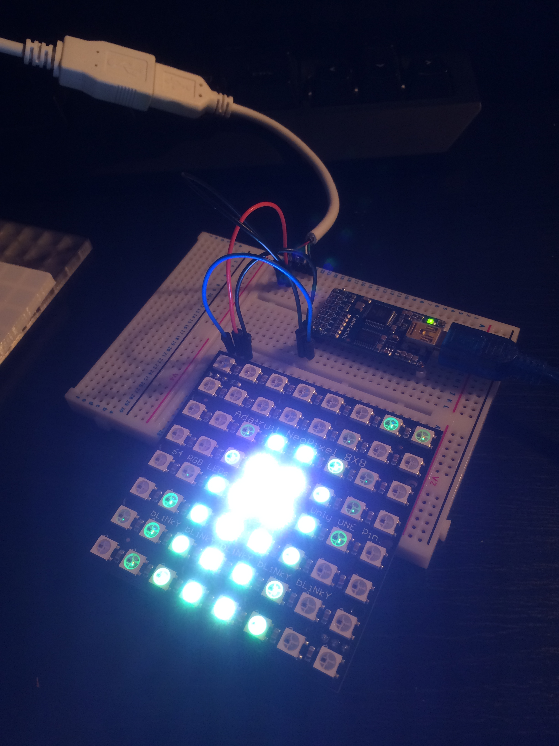
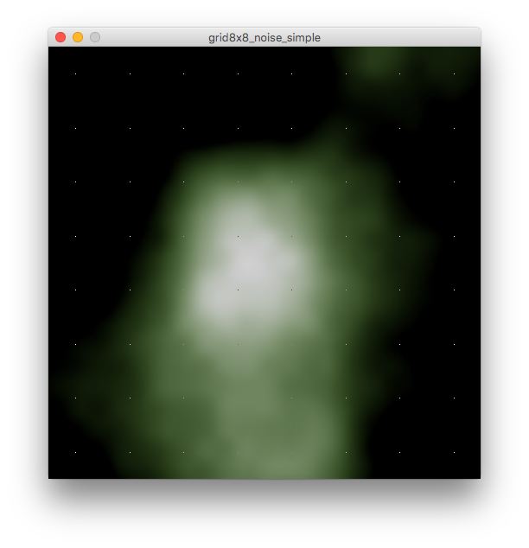
Premade Examples (noise)

Slide 10
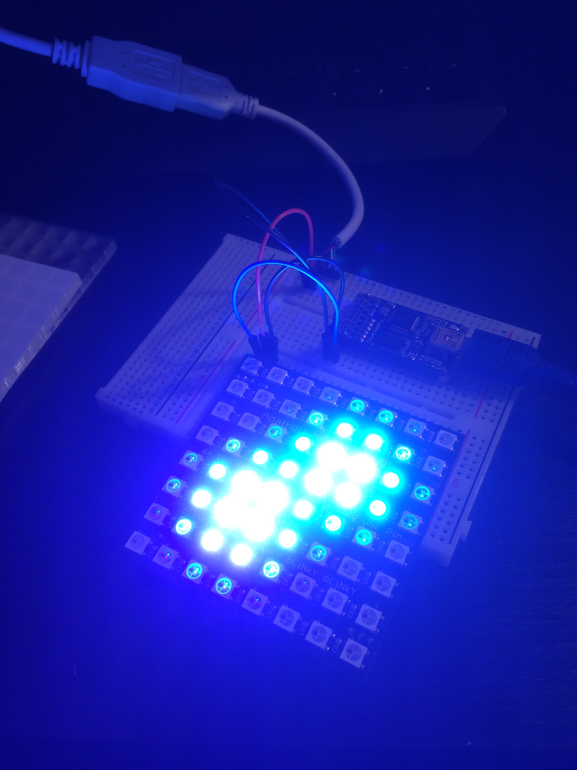
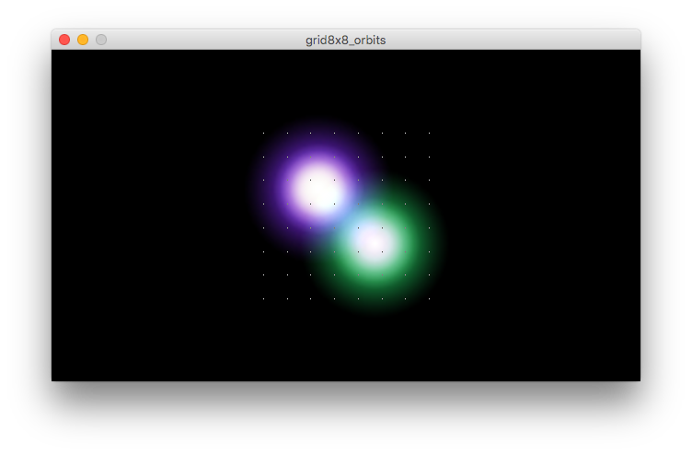
Premade Examples (orbit)

Slide 11
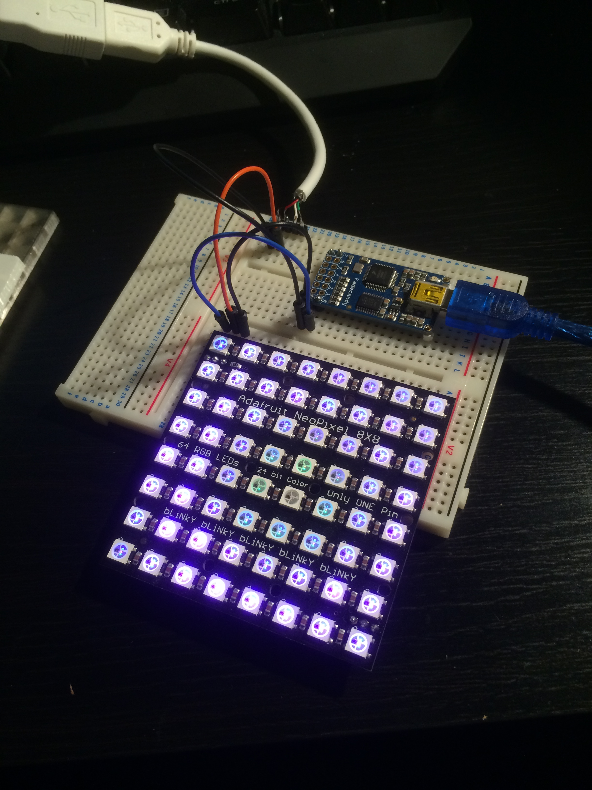
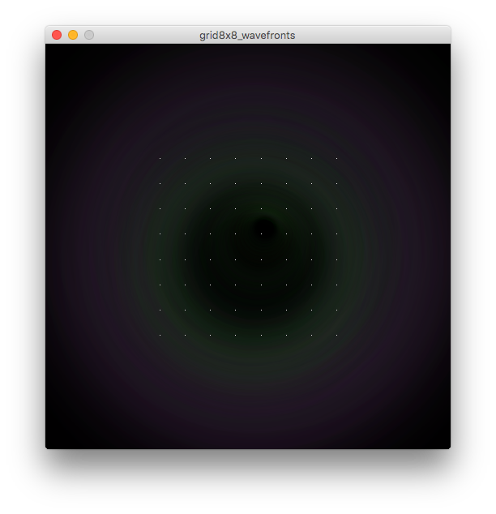
Premade Examples (wavefront)

Slide 12
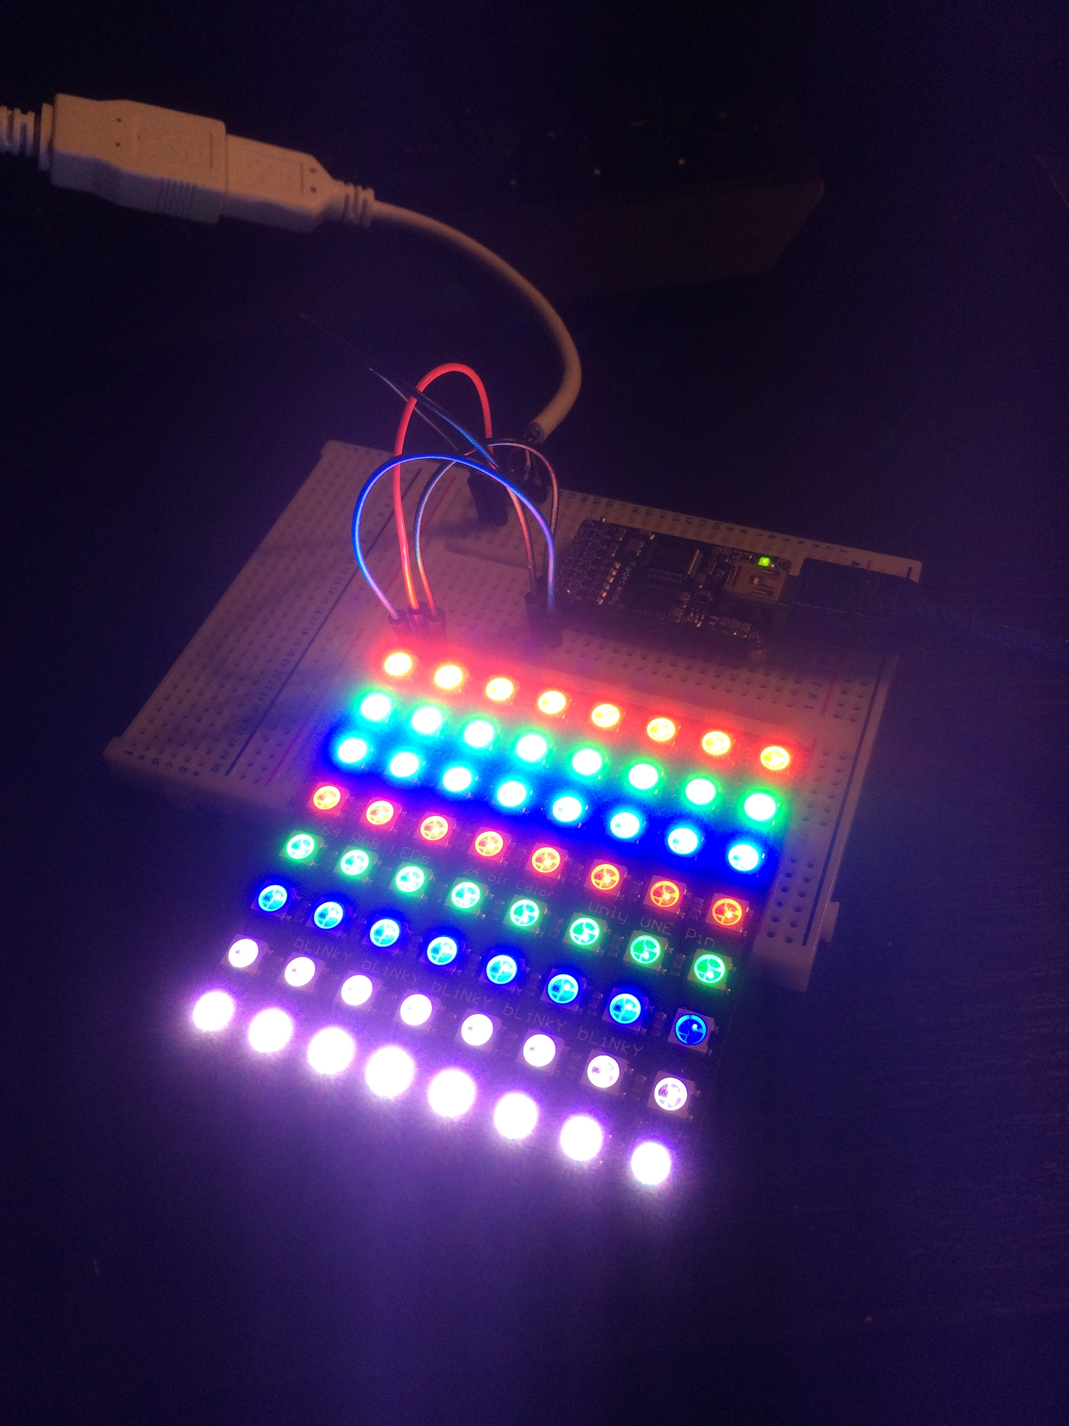
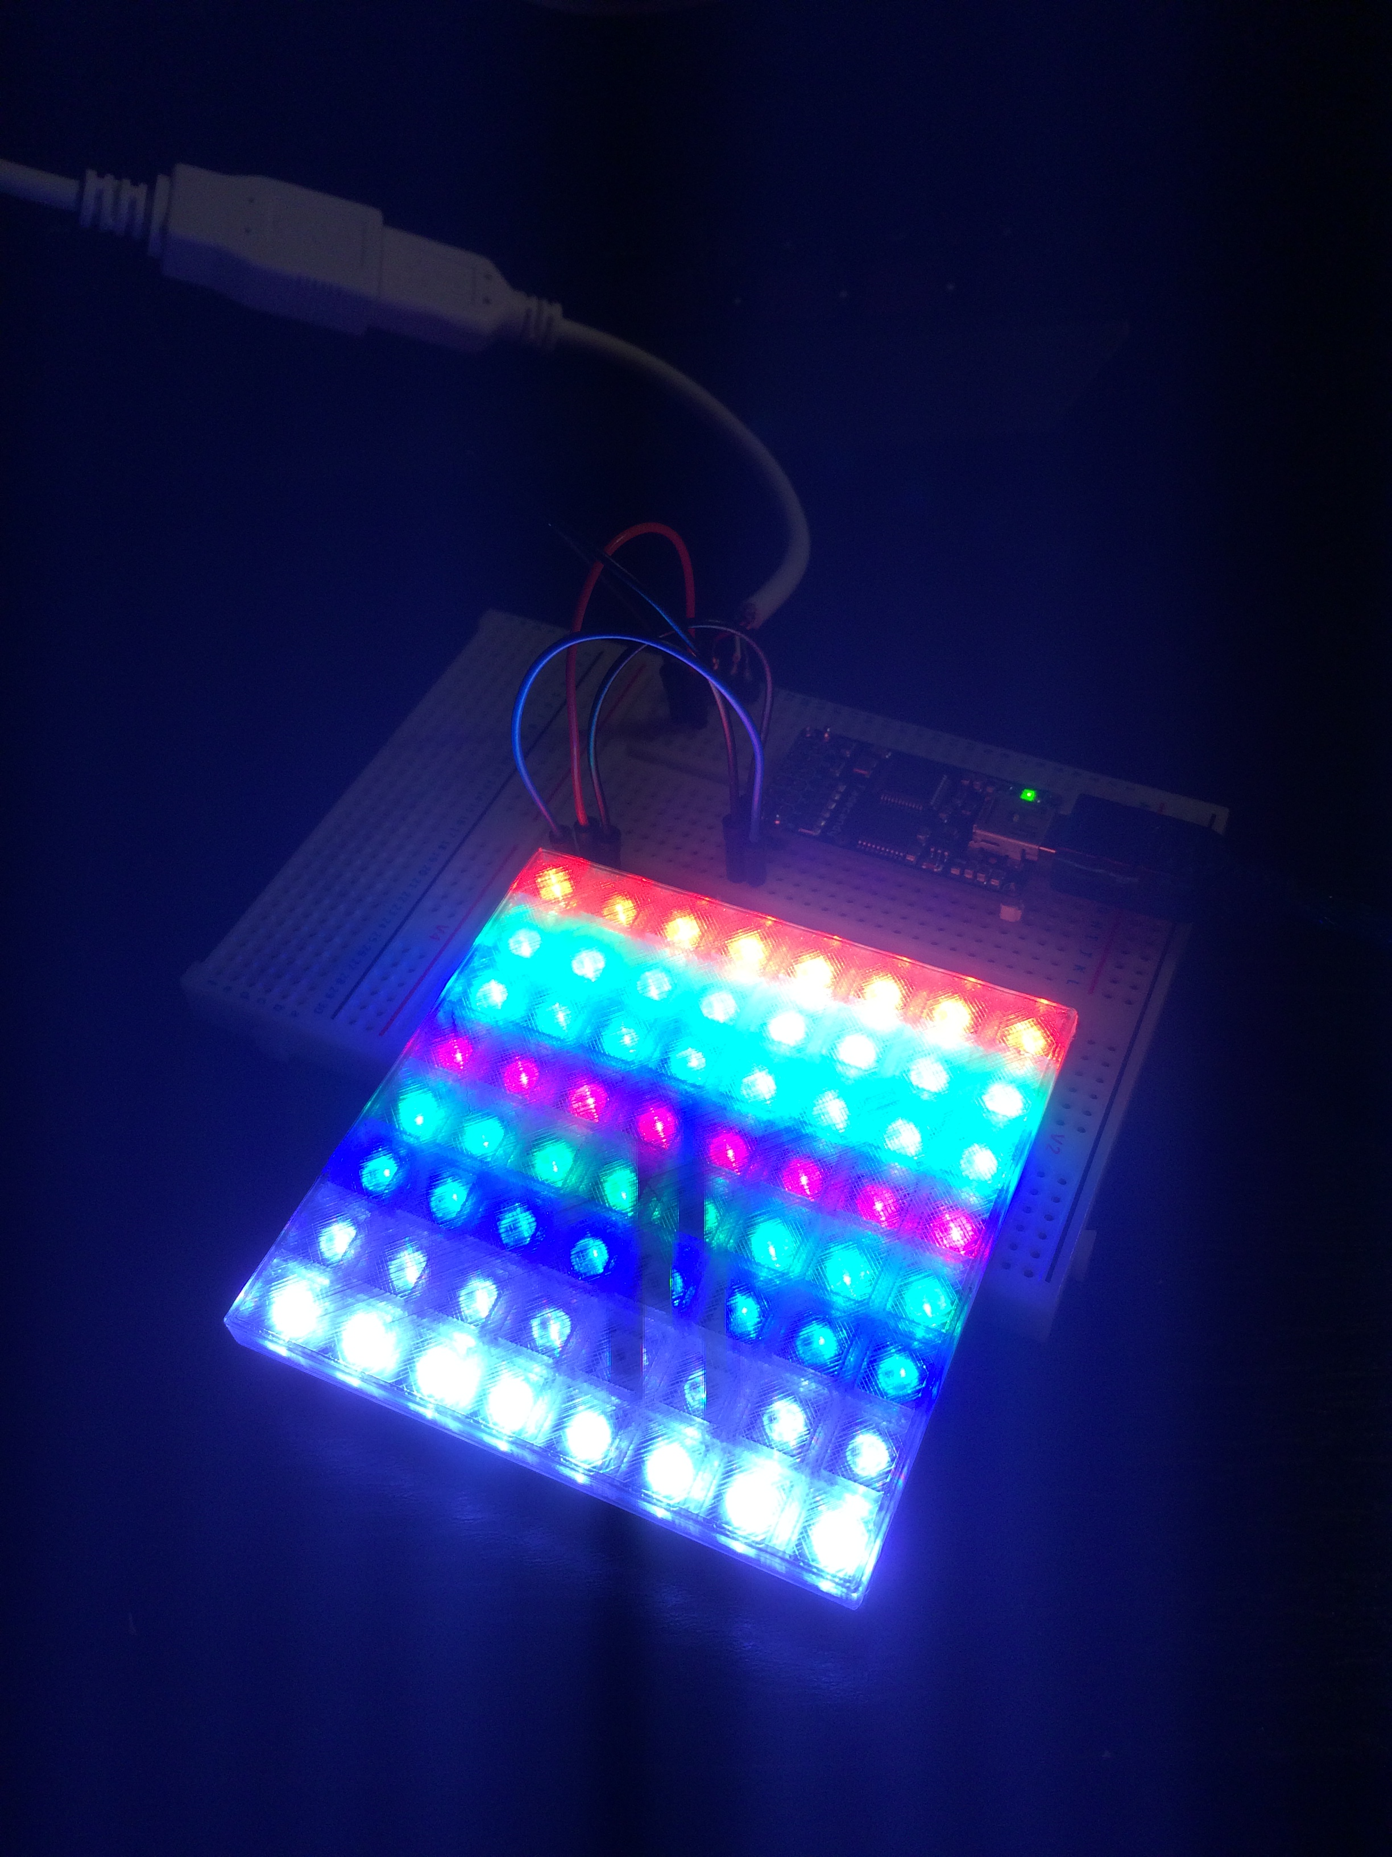
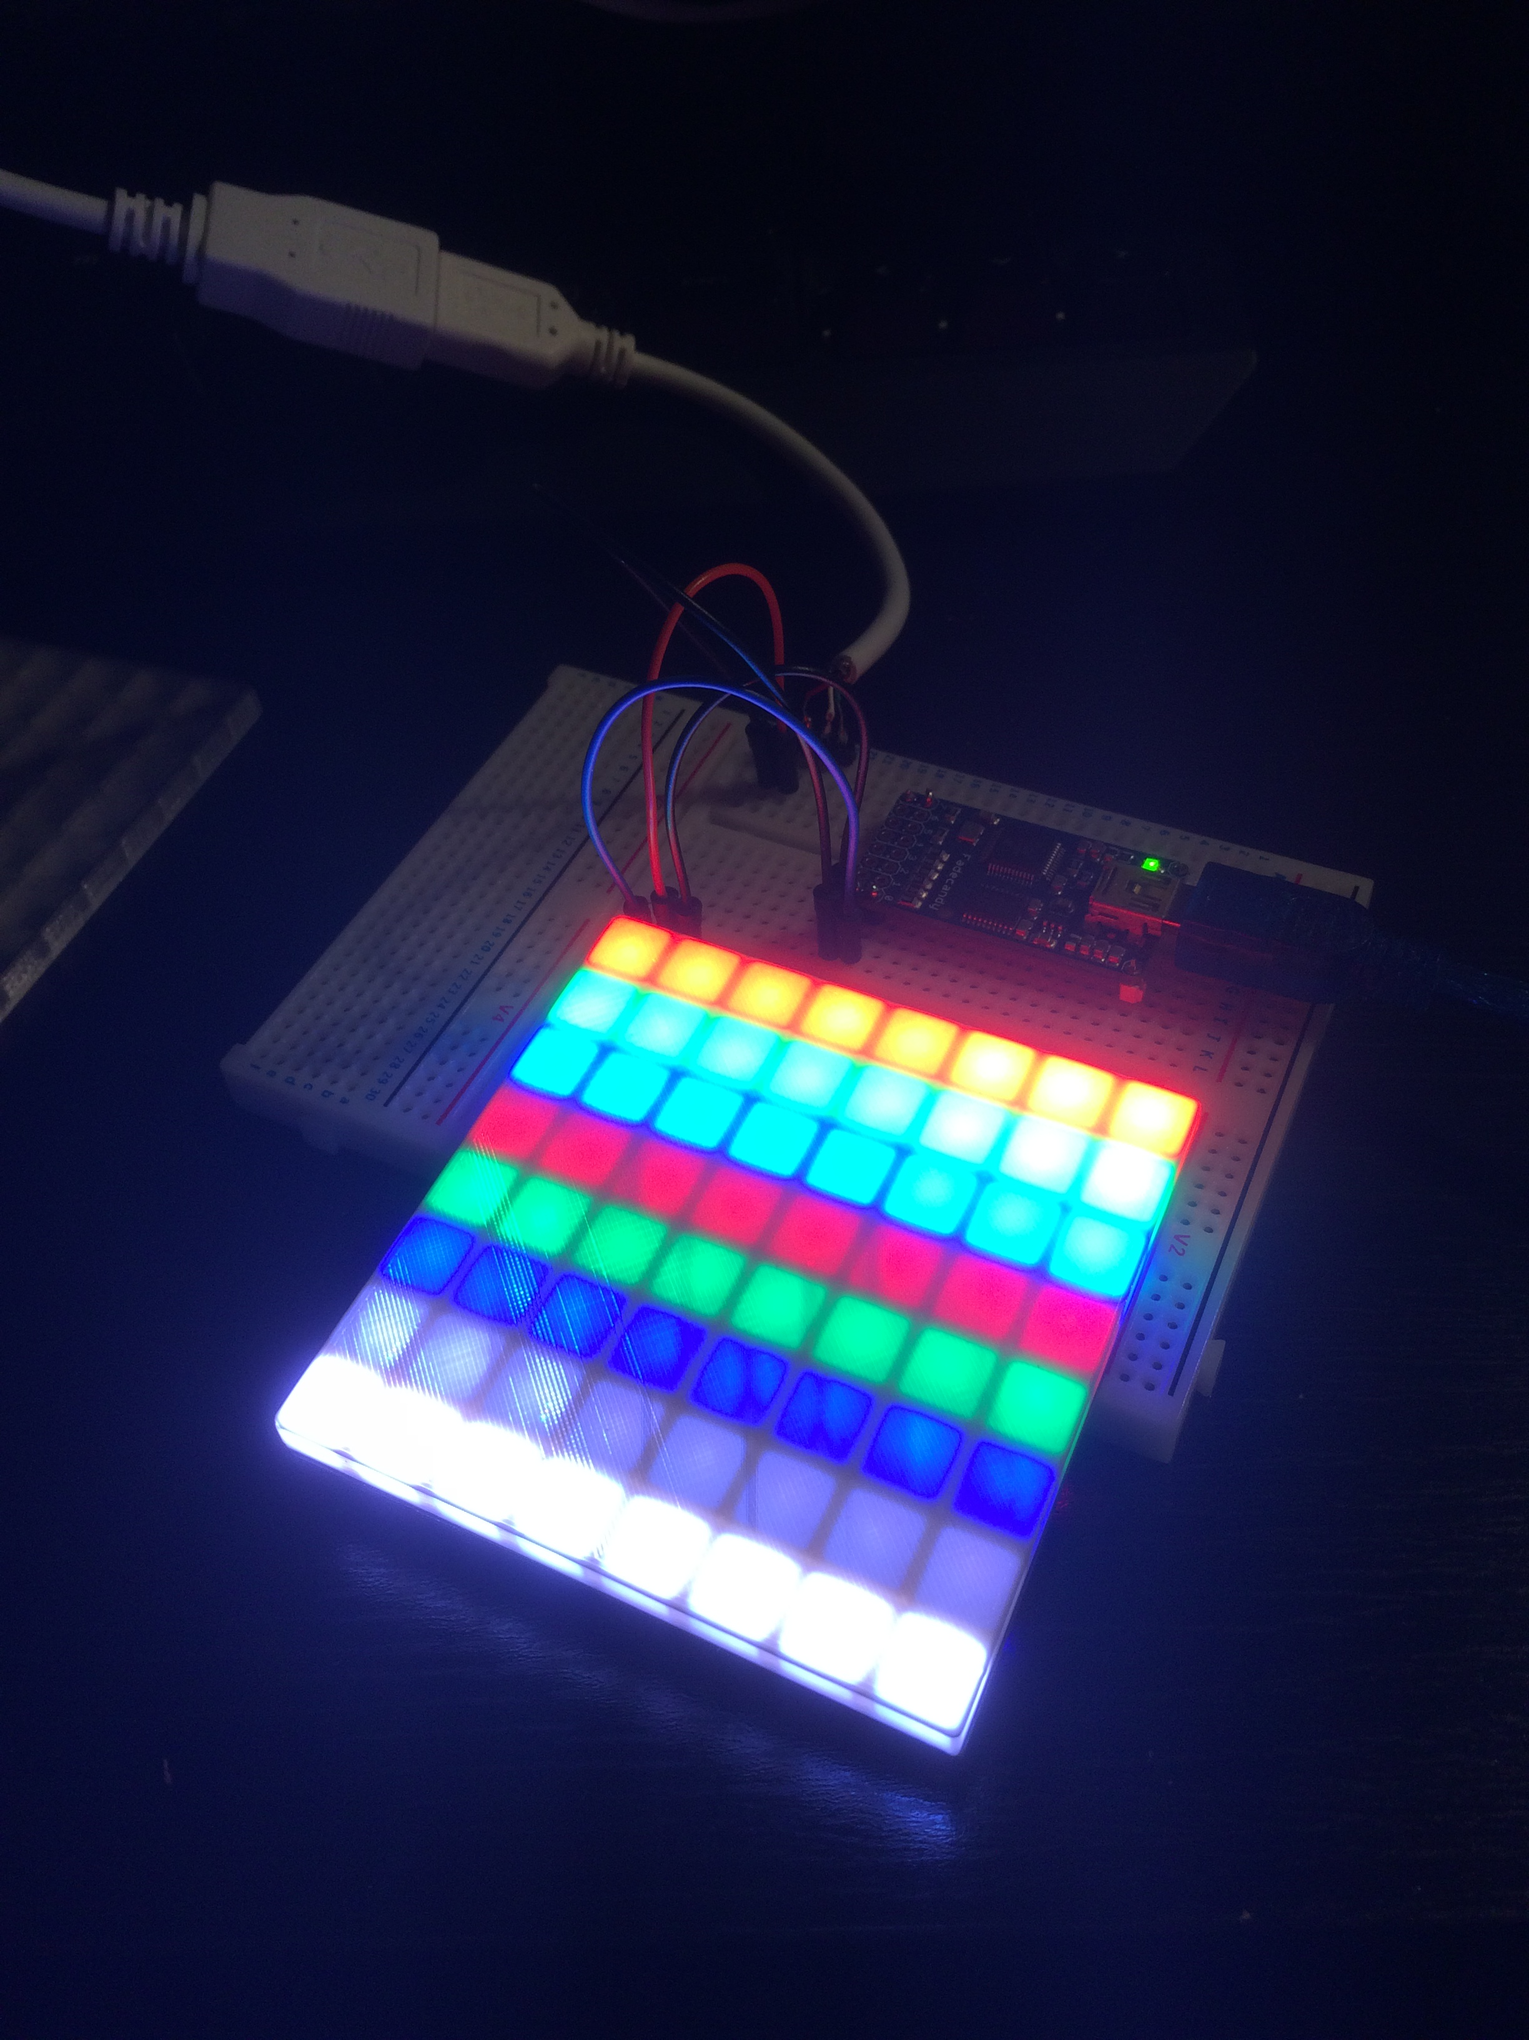
3D Printed Covers
(no cover)
(transparent PLA)
(white PLA)

Slide 13
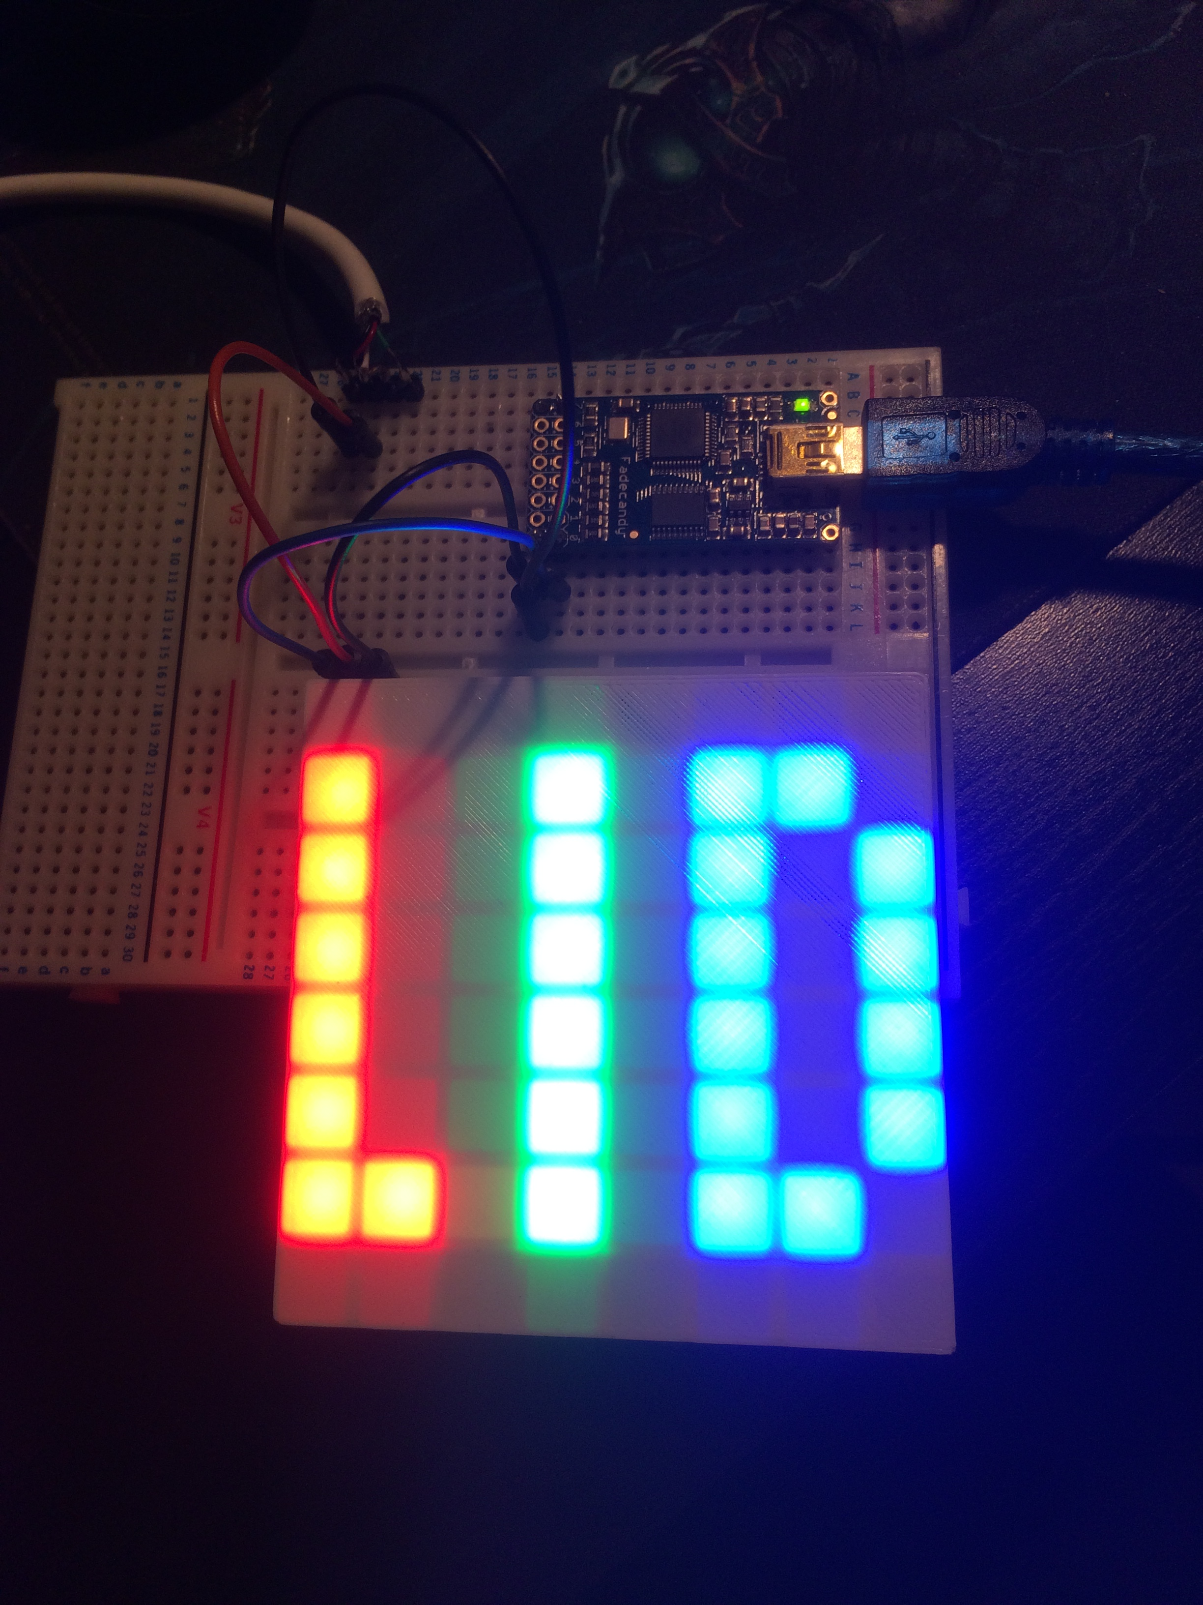
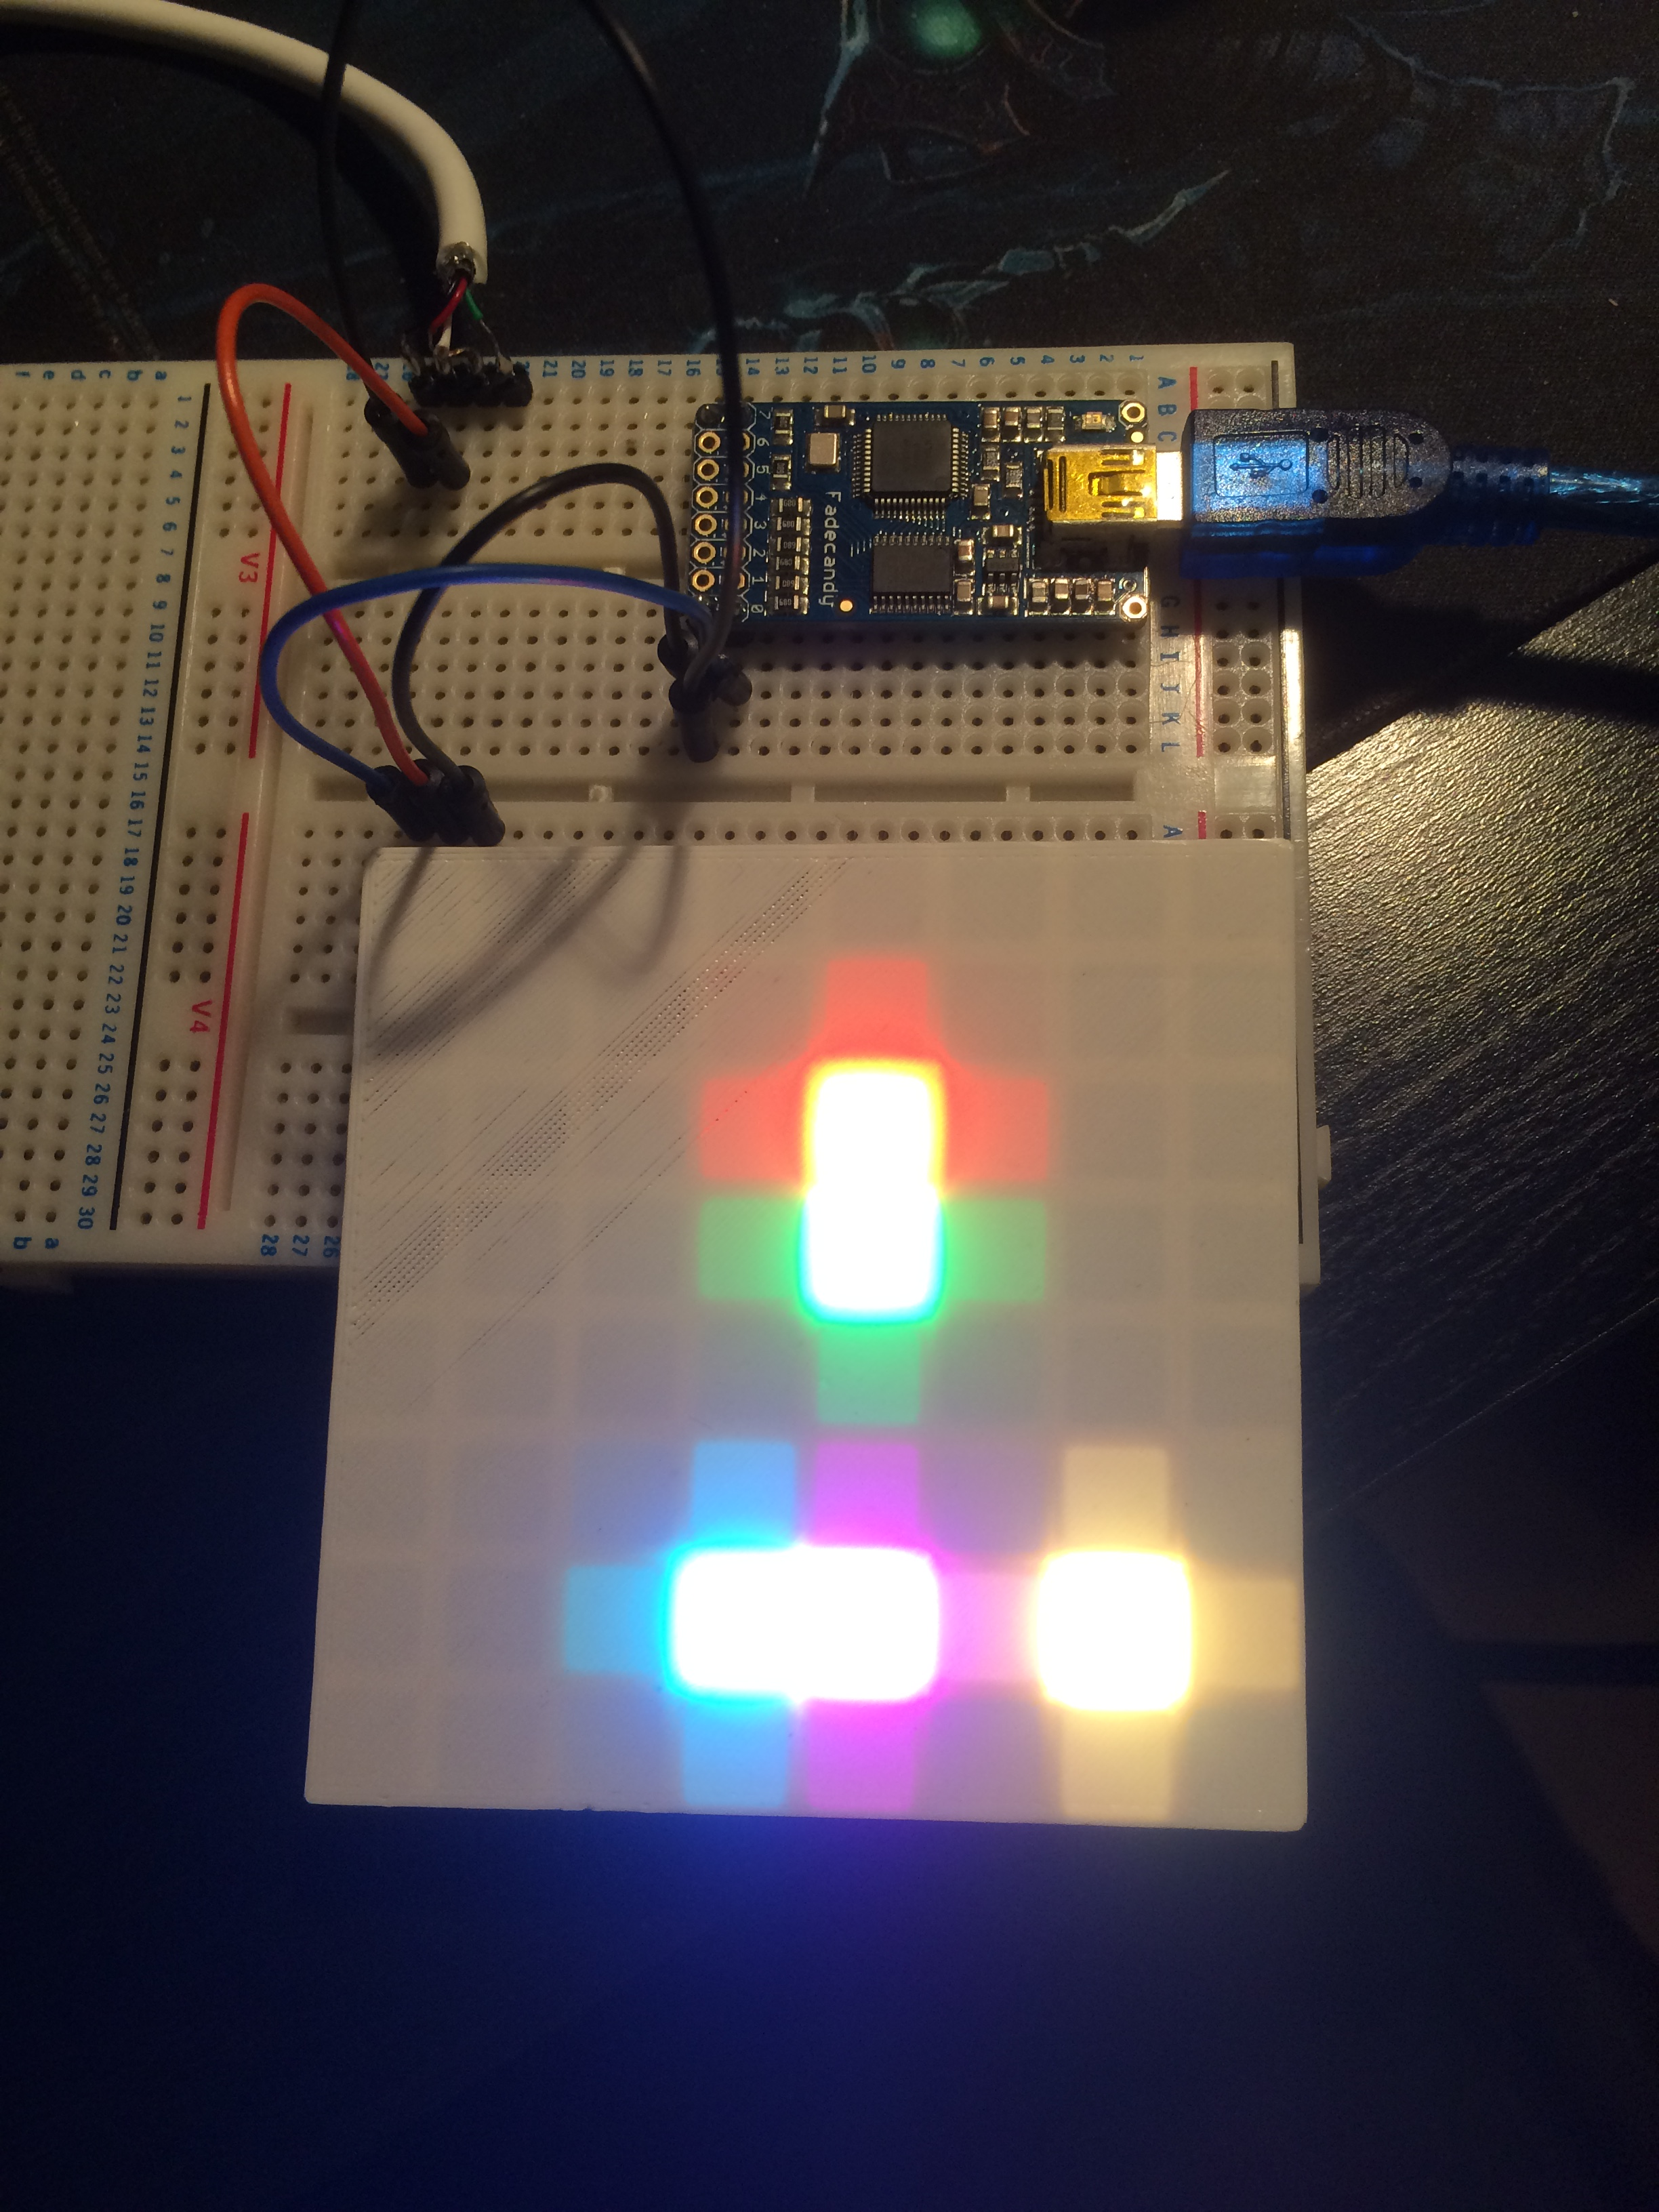
3D Printed Covers

